Slide 1
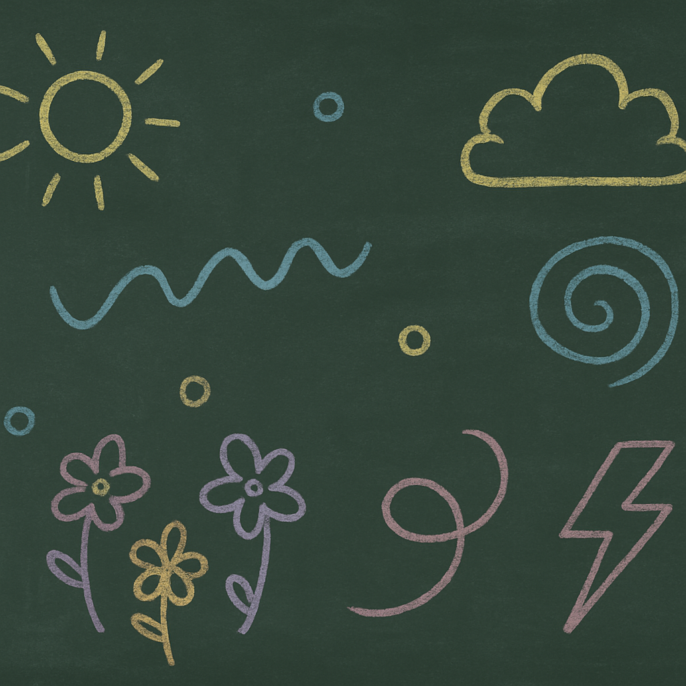

Articles (A, An, The)
Grammar Lesson for Class 3
Understanding and Using English Articles

Slide 2

Learning Objectives
Know what articles are
Use ‘a’, ‘an’ and ‘the’ correctly
Spot article errors in sentences
Practice with a short quiz
[1]

Slide 3



What Are Articles?
Articles are small words that come before nouns.
They tell us if we’re talking about any one thing or a specific thing.
Types of Articles:
• Indefinite articles (a, an)
• Definite article (the)
a dog
an umbrella
the sun
[2] [3] [4]

Slide 4



When to Use ‘A’
Use ‘a’ before words that begin with consonant sounds.
Examples: a bag, a cat
Not used before vowel sounds!
bag
cat
girl
[5] [6] [7]

Slide 5


When to Use ‘An’
Use ‘an’ before words that begin with vowel sounds.
Examples: an apple, an egg
Silent H: an honest man
Tip: Focus on the sound, not just the letter.
apple
egg
honest man
[8] [9] [10]

Slide 6


When to Use ‘The’
Use ‘the’ for specific nouns that both speaker and listener know.
Examples: the moon, the red ball, the teacher
Use when there is only one such thing
moon
red ball
teacher
[11] [12] [13]

Slide 7
Let’s Compare!
Article | Used When… | Example
a | before consonant sound | a banana
an | before vowel sound | an orange
the | when it’s specific | the book on my desk
[14] [15]

Slide 8
Fill in the Blank
I saw ___ elephant.
We walked into ___ house.
___ sun is bright today.
Use hand signals or your whiteboard to vote on the right article!
[16]

Slide 9
Choose the Correct Option
1. She has (a / an / the) umbrella.
2. They live near (a / an / the) airport.
3. He gave me (a / an / the) orange.
Discuss in pairs before revealing the answers!
[17]

Slide 10
Sentence Fixes
She ate a apple
→ She ate an apple
I saw an ball
→ I saw a ball
[18]

Slide 11
Mini Quiz
1. ___ eagle flew over the mountain.
2. He drew ___ picture of his house.
3. We looked at ___ stars in the sky.
4. She wants ___ ice cream cone.
5. ___ Earth moves around ___ sun.
Raise your hand when you know the answer!
[19]

Slide 12

Review & Wrap-Up
What is an article?
Articles are words before nouns that tell us whether the noun is general (a/an) or specific (the).
When do we use each?
‘a’ before consonant sounds
‘an’ before vowel sounds
‘the’ when it’s specific
Practice makes perfect! Write 3 sentences using articles correctly.
[22] [23] [24]

Slide 13
Bonus Challenge
Fix this silly sentence!
I saw a elephant in the moon!
→ I saw an elephant on the moon!
What other silly sentences can you fix using articles?
[25] [26]

