Slide 1
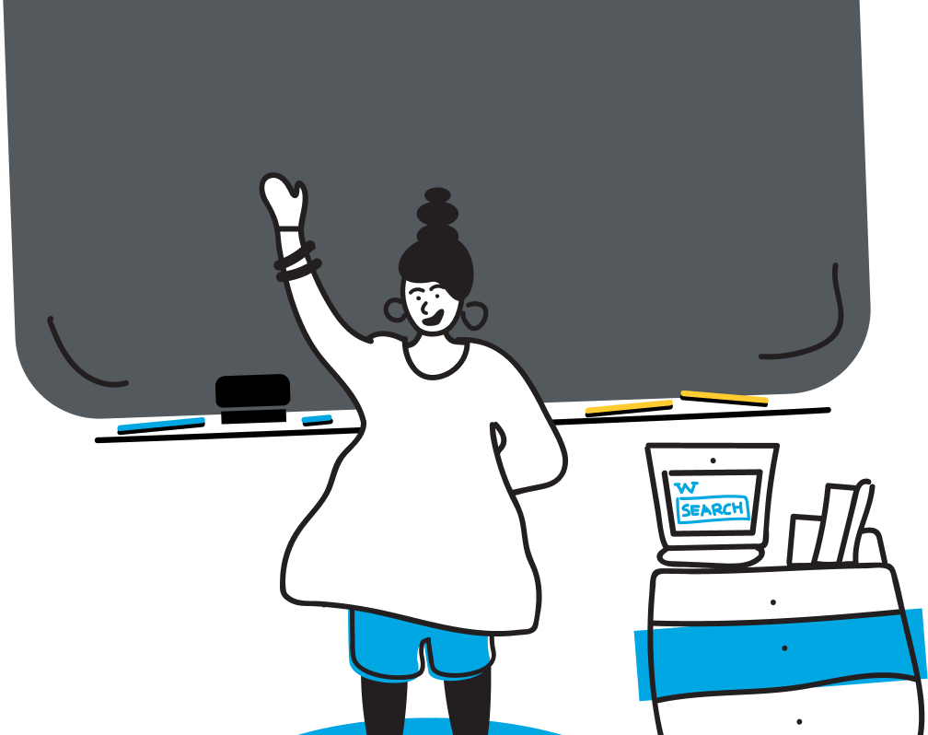

The 12 Basic Rules of Grammar
Learn to write clearly and correctly

Slide 2


What Is Grammar?
Definition
Grammar is the system of rules that structures sentences in the English language, laying the foundation for communication.
Why it matters
Good grammar helps you convey ideas clearly and ensures your listener or reader understands you as intended.
Correct
Let's eat, Grandma!
Incorrect
Let's eat Grandma!
[1] [2] [3]

Slide 3




Learning Objectives
Understand 12 foundational grammar rules
Spot and fix common mistakes
Practice with examples and a short quiz
Use grammar rules in your own writing
[4]

Slide 4
Rules 1–2
Capitalization & Punctuation
Start every sentence and proper noun with a capital letter. End sentences with a period, question mark, or exclamation point.
Correct: Yesterday, I went to Paris.
Incorrect: yesterday i went to paris
Subject–Verb Agreement
Match the verb's number to its subject: singular subjects take singular verbs; plural subjects take plural verbs.
Correct: The dogs bark loudly.
Incorrect: The dogs barks loudly
[5] [6]

Slide 5
Rules 3–4
Verb Tense Consistency
Keep your verbs in the same tense when describing actions that occur in the same time frame. Sudden shifts confuse readers.
Correct: She studied and then took the exam.
Incorrect: She studied and then takes the exam
Word Order (S‑V‑O)
English sentences usually follow the Subject–Verb–Object order. Put the subject first, then the action, followed by the thing acted on.
Correct: We read books.
Incorrect: Read we books
[7] [8] [9]

Slide 6
Rules 5–6
Article Use
Use 'a' or 'an' with singular count nouns when the identity is unknown; use 'the' when the noun is specific.
Correct: I saw a dog in the park.
The dog barked at me.
Incorrect: I saw dog in park
Adjective & Adverb Use
Adjectives describe nouns; adverbs describe verbs, adjectives, or other adverbs. Be sure to use the right form.
Correct: He is a quick runner.
He runs quickly.
Incorrect: He runs quick
[10] [11]

Slide 7
Rules 7–8
Pronoun Clarity
Choose pronouns that clearly refer to a specific noun and that agree in number and gender. Avoid ambiguous references.
Correct: Mary and Tom forgot their books.
Incorrect: Mary and Tom forgot her books
Preposition Usage
Prepositions show relationships in time, space, and direction. Use the correct preposition for the relationship you intend.
Correct: The cat is under the table.
Incorrect: The cat is in the table
[12] [13]

Slide 8
Rules 9–10
Sentence Completeness
Every complete sentence must have a subject (doer) and a predicate (verb and what follows) and express a complete thought.
Correct: The sun rises.
Incorrect: Running down the street
Avoiding Run‑Ons
Do not join independent clauses with only a comma. Use a conjunction, semicolon, or period to separate complete thoughts.
Correct: I enjoy swimming, and my brother likes hiking.
Incorrect: I enjoy swimming, my brother likes hiking
[14] [15]

Slide 9
Rules 11–12
Consistent Point of View
Stick to the same person (first, second, third) throughout a sentence or paragraph. Shifts confuse readers.
Correct: I enjoy reading because it relaxes me.
Incorrect: I enjoy reading because it relaxes you
Modifier Placement
Place modifiers next to the words they describe to avoid confusion or ambiguity.
Correct: With the telescope, I saw the man.
Incorrect: I saw the man with the telescope
[16] [17]

Slide 10
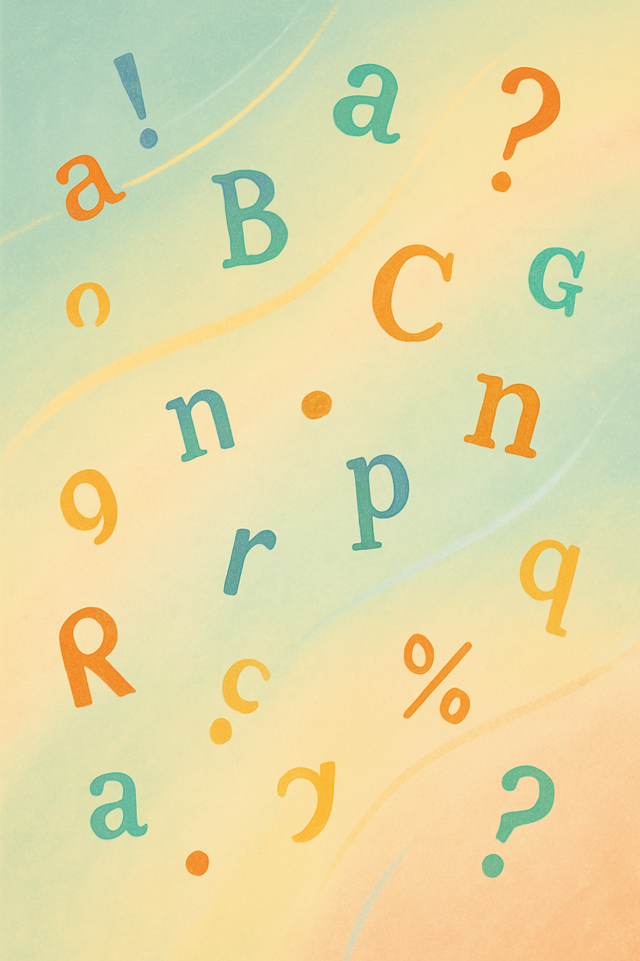
Practice: Fix the Sentences
Incorrect: the cat sleep on the mat
Correct: The cat sleeps on the mat.
Incorrect: we was running in the park
Correct: We were running in the park.
Incorrect: He walk to school he forgot his bag
Correct: He walked to school. He forgot his bag.
[18] [19]

Slide 11
Quick Quiz
1. Which sentence is complete?
A) Walking to the bus stop.
B) The dog barked.
C) Because she was late.
2. Choose the correct verb form:
A) He go to school
B) He goes to school
C) He going to school
3. Select the properly punctuated sentence:
A) Where are you
B) Where are you?
C) Where are you!
4. Pick the correct article:
A) She bought an umbrella
B) She bought the umbrella
C) She bought umbrella
5. Which sentence uses pronouns correctly?
A) Everyone should bring their book
B) Everyone should bring his book
C) Everyone should bring them book
Discuss your answers with a partner or self‑check after class.
[20] [21]

Slide 12


Worksheet & Lesson Plan
Work in pairs to complete the worksheet.
Download: Grammar Worksheet
The worksheet reinforces today’s rules through short exercises. At the end of class, review your answers together.
Download the worksheet
Work in pairs
Remember:
Complete the quiz before leaving class.
Turn in your worksheet at the next session.
Bring questions to the FAQ slide.
[22]

Slide 13

Common Questions
Do I have to memorise all the rules?
Memorization helps, but practice makes them stick. Focus on understanding and applying the rules as you write.
Why are there so many exceptions?
English borrows from many languages, so its patterns aren’t always perfect. Learn the rules first, then explore exceptions.
What if I make a mistake?
Mistakes are part of learning. Identify them, correct them, and you’ll improve your communication skills.
[23]

Slide 14

Review & Wrap‑Up
Key Takeaways
Grammar provides the structure to communicate clearly.
Remember the 12 rules: capitalisation, punctuation, agreement, tenses, word order, articles, modifiers, etc.
Practice often – read, write, and edit your work.
Ask questions if you’re unsure and review these slides as needed.
Homework: Write five original sentences using at least three of the grammar rules covered today.
[24] [25]

