Slide 1
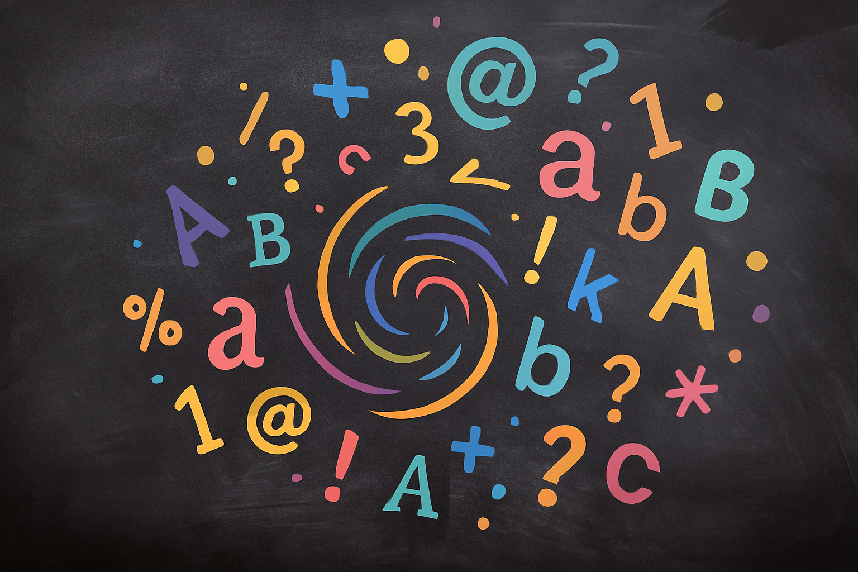

Why Grammar Matters
10 Reasons to Use It Every Day

Slide 2
What Is Grammar?
Grammar is the set of rules that control how sentences are formed.
These rules cover spelling, punctuation, sentence structure and parts of speech.
They help us write and speak clearly.
Spelling
Punctuation
Sentence
Structure
Parts of
Speech

Slide 3

Why Does Grammar Matter?
Would you trust a job application with mistakes?
Have you ever misunderstood a message because of grammar?
In the next slides we'll explore 10 reasons grammar matters in writing, speaking and daily life.
[3][4]

Slide 4

Clarity & Understanding
Clear communication ensures your reader understands your message and prevents misunderstandings.
Proper grammar helps readers follow the relationships between ideas and improves comprehension.
[5][6][7]

Slide 5

Credibility & First Impressions
Good grammar makes you appear professional, trustworthy and competent.
Mistakes on resumes, job applications or essays damage first impressions and cost opportunities.
Clear language makes you more likeable and credible to others.

Slide 6

Communication & Expression
Grammar helps you express ideas clearly and makes writing easy to read.
Correct sentences make you more persuasive and likeable to your audience.
Learning grammar rules improves your writing skills and helps you share complex ideas effectively.

Slide 7

Language Learning & Reading
Understanding grammar gives you tools to decode sentences and improve reading comprehension.
Knowing grammar rules helps when learning new languages and communicating across cultures.
Mastery of grammar builds confidence when speaking and writing.
[17][18][19][20]

Slide 8

Academic Success & Career Skills
Strong grammar leads to better grades on essays, tests and assignments.
Employers value clear writing; mistakes on resumes or emails can hurt job prospects and promotions.
Mastery of grammar builds confidence and credibility that opens doors throughout your life.

Slide 9
Quick Quiz
Test your understanding! Choose the correct answer for each question.
1. Which sentence is correct?
Their going to the store.
They're going to the store.
2. Why might grammar be important in a job interview?
It shows you can follow rules and communicate clearly.
It lets you use slang freely.
Interviewers like long sentences.
3. Which statement is a reason grammar matters?
It makes writing difficult to read.
It helps you communicate ideas clearly and be taken seriously.
It is only important in English class.

Slide 10
Real‑Life Examples
Example 1:
Let’s eat grandma!
Let’s eat, grandma!
Example 2:
I found the dogs ball.
I found the dog’s ball.
How does punctuation change meaning?

Slide 11

Wrap‑Up & Key Takeaways
Grammar = Confidence, Clarity & Credibility
Read widely to see grammar in action.
Practice writing and speaking to strengthen your skills.
Review rules and ask for feedback to keep improving.

Slide 12

Exit Ticket
Write down one reason grammar is important to you.
OR
Which reason surprised you most — and why?
Share your answer with a classmate or write it on an exit ticket to turn in at the end of class.

