Slide 1


Metaphors for Happiness
Describing Joy Through Figurative Language

Slide 2


What Is a Metaphor?
A metaphor compares one thing to another by saying it is something else.
Metaphors are figures of speech and are not literally true.
They help us picture emotions and ideas in a vivid way.
Metaphor
Her smile was sunshine.
Simile
Her smile is like sunshine.
[1][2][3][4]

Slide 3
Why Use Metaphors to Describe Happiness?
Plain:
I am very happy.
Metaphor:
I'm walking on air.
Metaphors turn feelings into vivid pictures.
They make language colourful and emotional.
They encourage creativity and improve writing and speech.
[5][6][7]

Slide 4
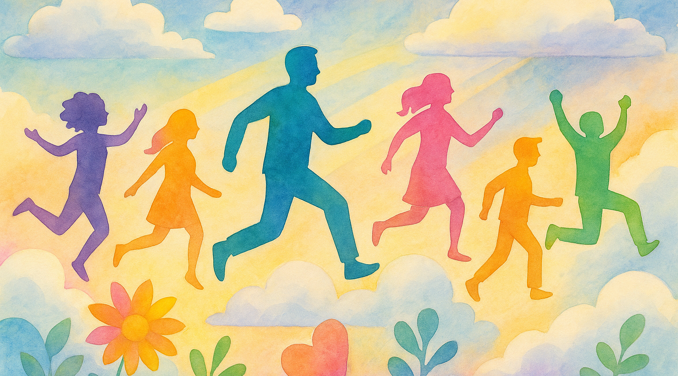
Nature & Light Metaphors
A ray of light
Someone or something that brings joy when they appear.
Example: She is a ray of light to everyone around her.
Her smile was sunshine
Describes a smile that feels bright, warm and hopeful.
Example: His compliment made her smile sunshine.
A garden in bloom
A situation thriving with positivity and growth.
Example: After the good news, the classroom felt like a garden in bloom.
[8][9][10][11]

Slide 5

Movement Metaphors
Walking on air
Feeling light and worry‑free after something positive happens.
Example: She was walking on air after she aced her test.
Jumping for joy
Being so happy you can’t sit still.
Example: He was jumping for joy when he got the scholarship.
A skip in your step
A burst of energy that puts a bounce in your walk.
Example: The sunny day put a skip in her step.
[12][13][14]

Slide 6
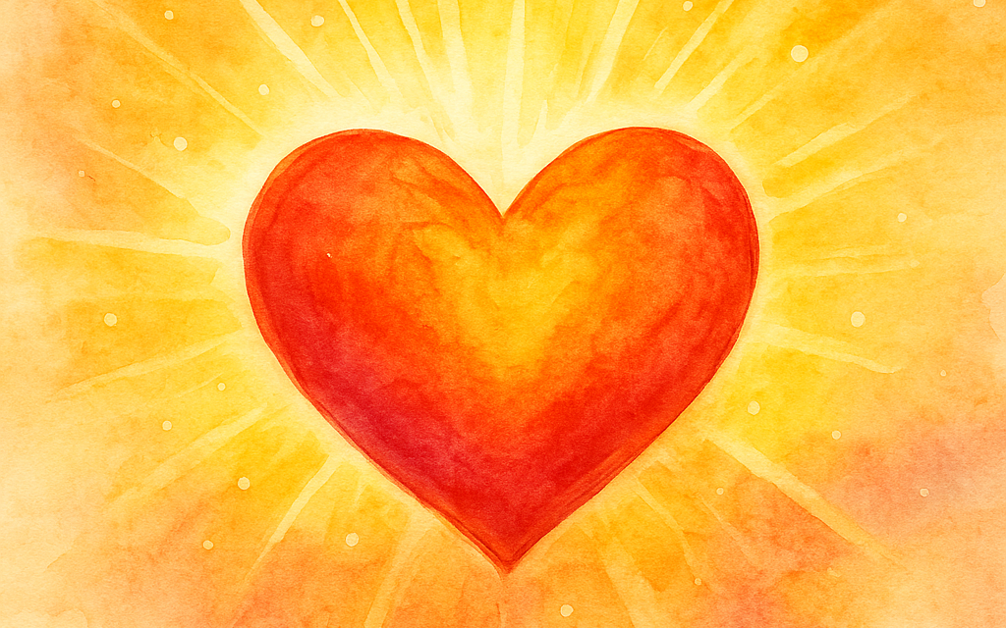
Emotion & Heart Metaphors
Happiness is a warm blanket
Happiness feels cozy and safe, like being wrapped in a blanket.
Example: Sitting by the fire was happiness as a warm blanket.
Heart skips a beat
Being so happy or excited that your heart seems to leap.
Example: When she saw her best friend arrive unexpectedly, her heart skipped a beat.
Happiness is a hard laugh on a tough day
Finding joy and humor even when things are difficult.
Example: Even though finals were stressful, a joke with friends was a hard laugh on a tough day.
[15][16][17]

Slide 7
Mini Practice: What Does It Mean?
1. On cloud nine
2. Sunshine in my soul
3. Over the moon
For each metaphor above, decide: What emotion does it express? Is it literal or figurative? Jot down your guesses before we discuss!
[18][19][20][21]

Slide 8

Build Your Own Metaphor
Think of something joyful — a song, a place, a memory.
How could you turn it into a metaphor?
Example: Joy is a balloon ready to lift off.
Write your own metaphor and share with a partner!
[22]

Slide 9

Quiz Time
1. What does “Jumping for joy” mean?
A) Feeling nervous B) Being extremely happy C) Taking a leap of faith
2. Which metaphor expresses quiet happiness?
A) Heart skips a beat B) A garden in bloom C) Jumping for joy
3. “Walking on air” describes
A) Feeling depressed B) Feeling carefree and happy C) Travelling by airplane

Slide 10

Recap & Key Takeaways
What is a metaphor?
A creative comparison that says something is something else to create vivid imagery.
Categories of happiness metaphors:
• Nature & light: rays of light, sunshine, gardens in bloom
• Movement: walking on air, jumping for joy, a skip in your step
• Emotion & heart: warm blankets, heart skips a beat, hard laughs on tough days
Keep listening for metaphors in stories and songs and try creating your own!
[23][24][25]

Slide 11

Worksheet & Homework
Download the worksheet linked on the blog post to practice these metaphors.
Write three original sentences using metaphors from each group (nature/light, movement, emotion/heart).
Reflect on a metaphor you’ve heard before in a book, song or conversation. What does it compare and how does it make you feel?
[26]

Slide 12

Exit Ticket & Wrap-Up
Exit question:
What’s one metaphor from today you could use in your own story or conversation?
Review today’s themes:
• Nature & light metaphors capture brightness and growth.
• Movement metaphors convey energy and freedom.
• Emotion & heart metaphors illustrate warmth and inner joy.
Challenge yourself to listen for metaphors in songs, books and everyday speech this week!
[27][28]

